Slide 1

Socket Programming and the Implementation of a World Wide Messaging System

Slide 2
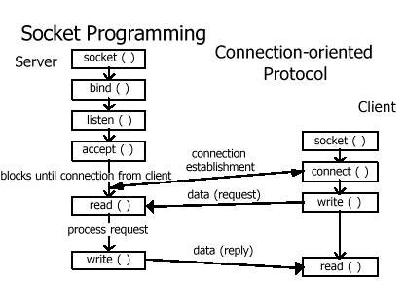


Socket Programming
* Source/destination address
* The text message

Slide 3

Socket Programming – Cont’d
1 teacher
8 children
8 connections

Slide 4

Socket Programming – Cont’d
N = 9 participants
Number of Connections = N(N-1)/2 = 36 connections

Slide 5
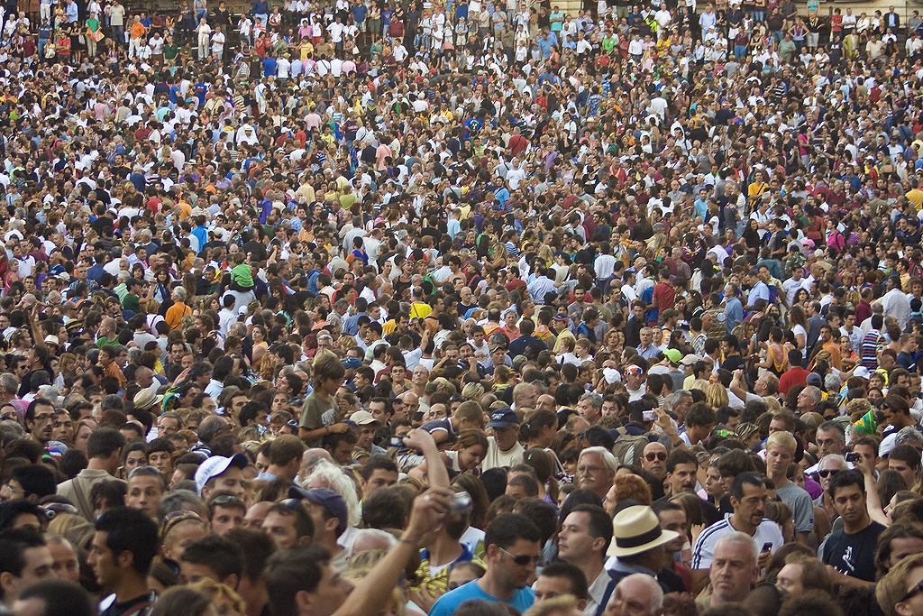
Socket Programming – Cont’d
Maximum socket
connections, Linux:
65,536 to about 300,000.
Windows: 30,000 to about 65,536
N, number of participants | Number of connections = N(N-1)/2
10 | 45
100 | 4950
10,000 | 49,995,000
1,000,000 | 499,999,500,000

Slide 6

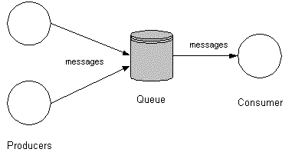
Intermediary Service
Message Pump
Dispatcher,…
Network Node
N, number of participants | Number of connections = N
10 | 10
100 | 100
10,000 | 10,000
1,000,000 | 1,000,000

Slide 7
Requirements of Network Communications
Throughput (Speed, Volume)
Reliability (Error correction)
Latency (Message Delay)
Security (Encryption/Decryption)
We wish to avoid network congestion, where a link or node carries too much data that its quality of service deteriorates.
We wish the network to be resilient in times of high usage.
We wish to prevent unauthorized access, misuse, or denial of the computer network.

Slide 8


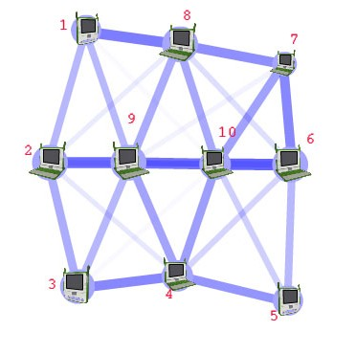
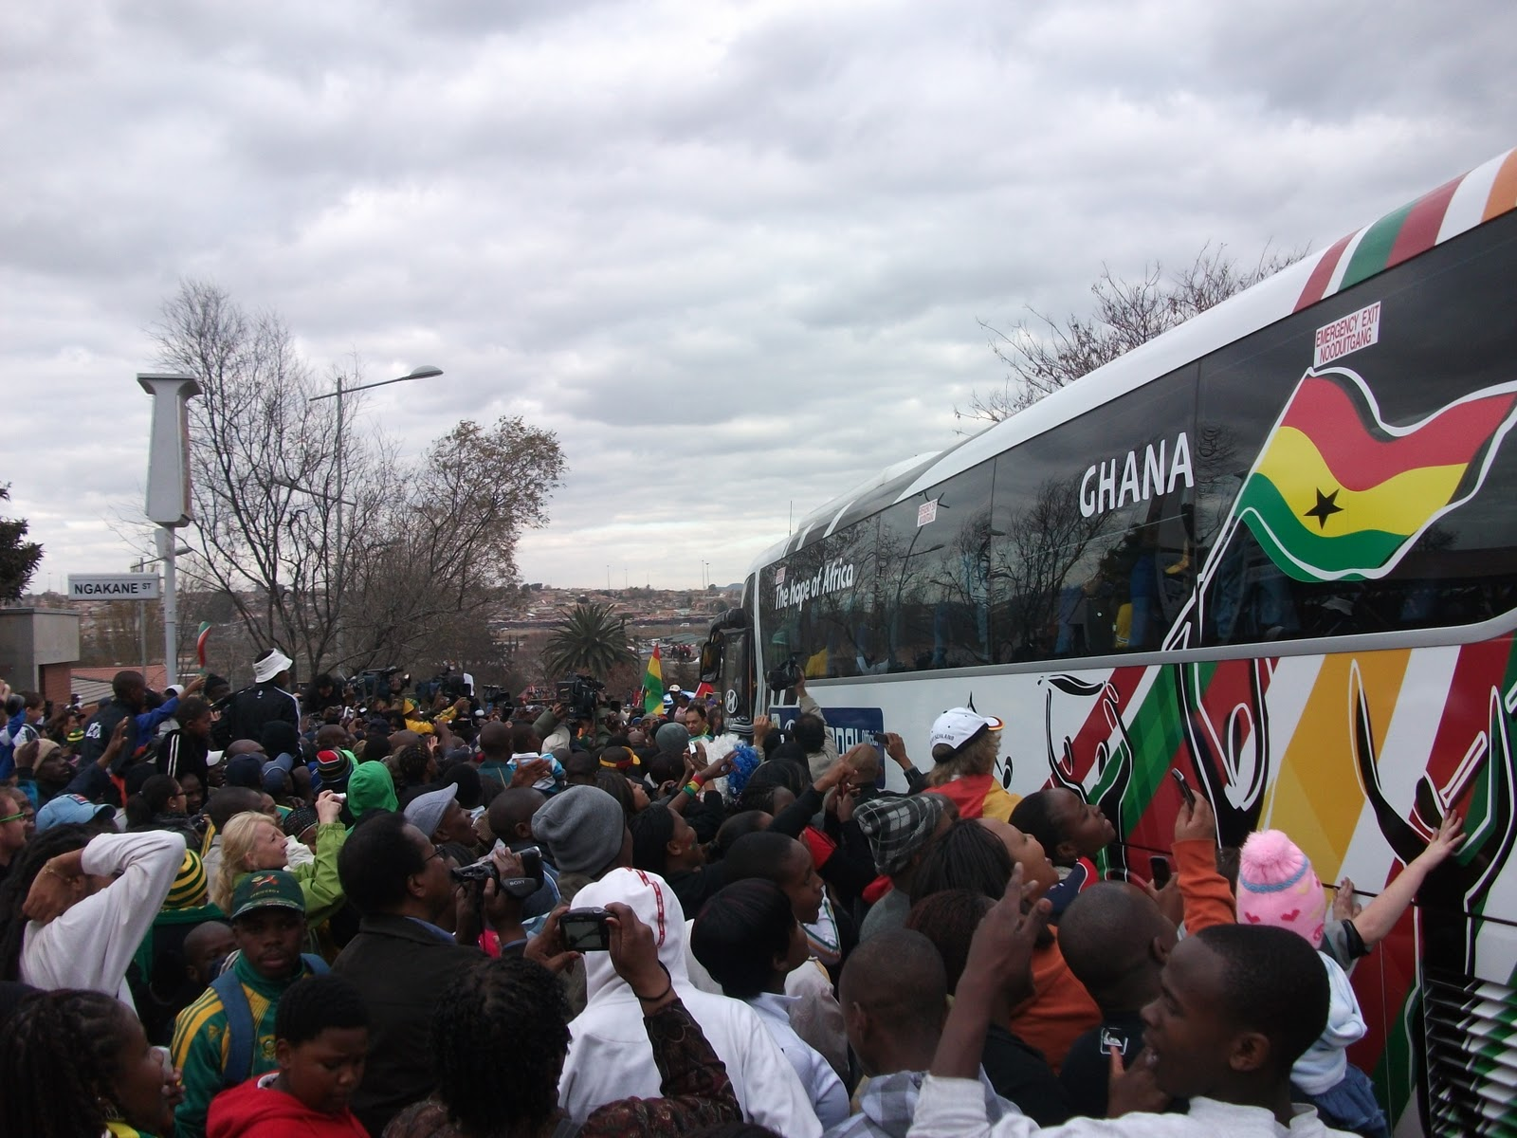

Multi-Node Network
Need to find the shortest path from one participant to the other.
Participants are not limited to one network entry point.

Slide 9
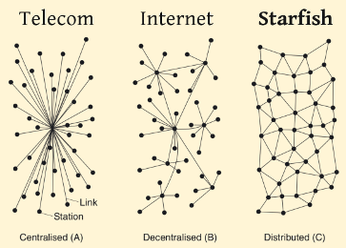
Multi-Node Network Architectures
A global Network of 80,000,000 participants
needs at least 500 Network Nodes.
160,000 participants / node
Mostly Distributed
Maybe Decentralized network clusters in large population areas

Slide 10
Aspects of Distributed Networking
Needs:
Registration (DataBase)
Routing (Dynamic Router)
Monitoring (Diagnostics)
Bridging (Interfacing)
Risks:
Network Outages (Natural Causes/System Upgrade)
Network Congestion (Bursts of Traffic)
Attacks on the Network (Spying, Viruses)

Slide 11
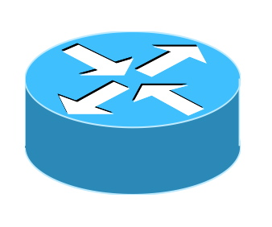

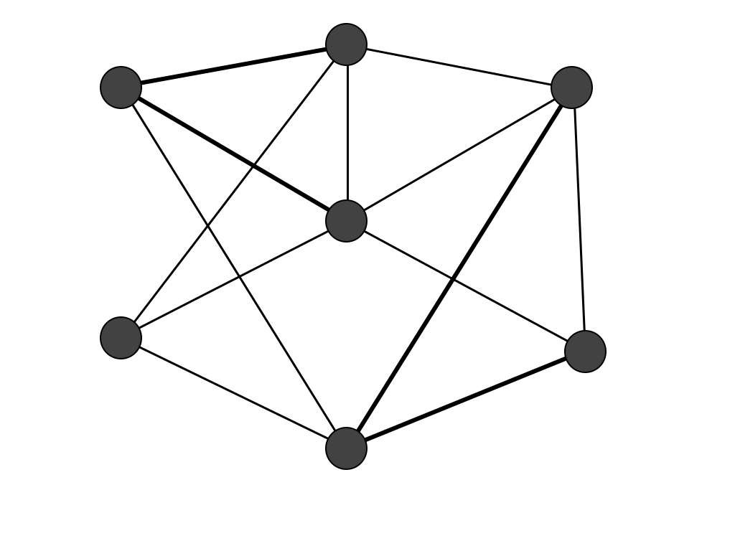
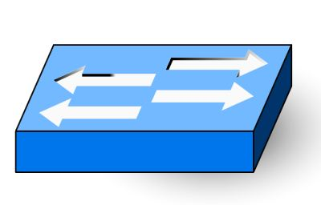

Global Distributed Networking - Components
Router
Dynamic memory cache
of routing information
Diagnostics
Monitors heartbeats
Maintains centralized
routing information
Gives the signal to update
their memory caches
Registration Database
Validates participants
and their privileges
Network nodes
Bridge
-To enterprise private
networks or devices
-To other network clusters
Mostly peer-to-peer, with some centralized components

Slide 12

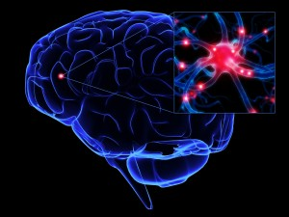
Global Distributed Networking - A Living Organism
A Global Messaging System
The Human Brain
Shortest path (neural pathway)
Dynamic (learning)
Network congestion (headache)
Network crash (stroke)
Security (immune system)

